Slide 1
AC Circuits.
A sinusoidal current is usually referred to as alternating current (ac).
Such a current reverses at regular time intervals and has alternately positive and negative values. Circuits driven by sinusoidal current or voltage sources are called ac circuits

Slide 2
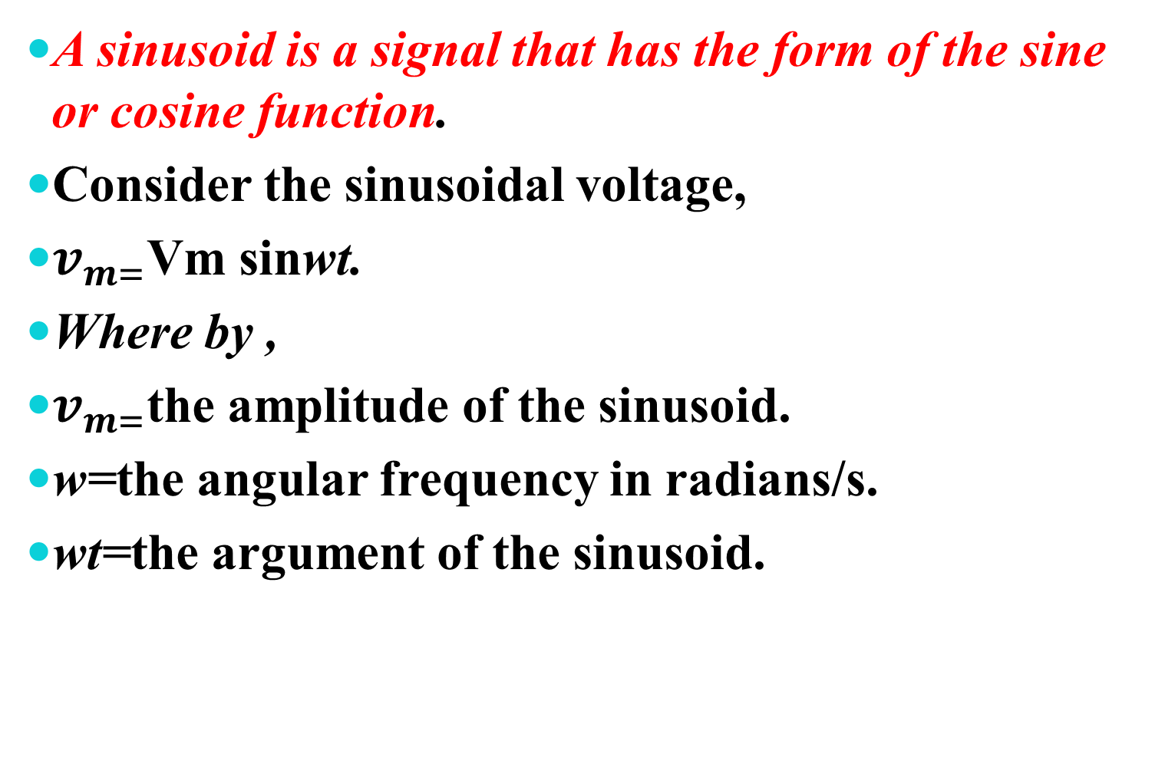
A sinusoid is a signal that has the form of the sine or cosine function.
Consider the sinusoidal voltage,
$v_{m=}$Vm sinwt.
Where by ,
$v_{m=}$the amplitude of the sinusoid.
w=the angular frequency in radians/s.
wt=the argument of the sinusoid.

Slide 3
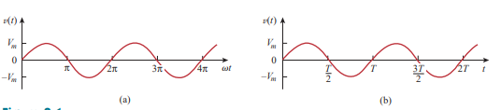

The sinusoid is shown in Fig.(a) as a function of its argument and in Fig.(b) as a function of time. It is evident that the sinusoid repeats itself every T seconds;thus,T is called the period of the sinusoid.
T=$\frac{2π}{W}$, f =$\frac{1}{T} ,$ w$=2πf$,

Slide 4
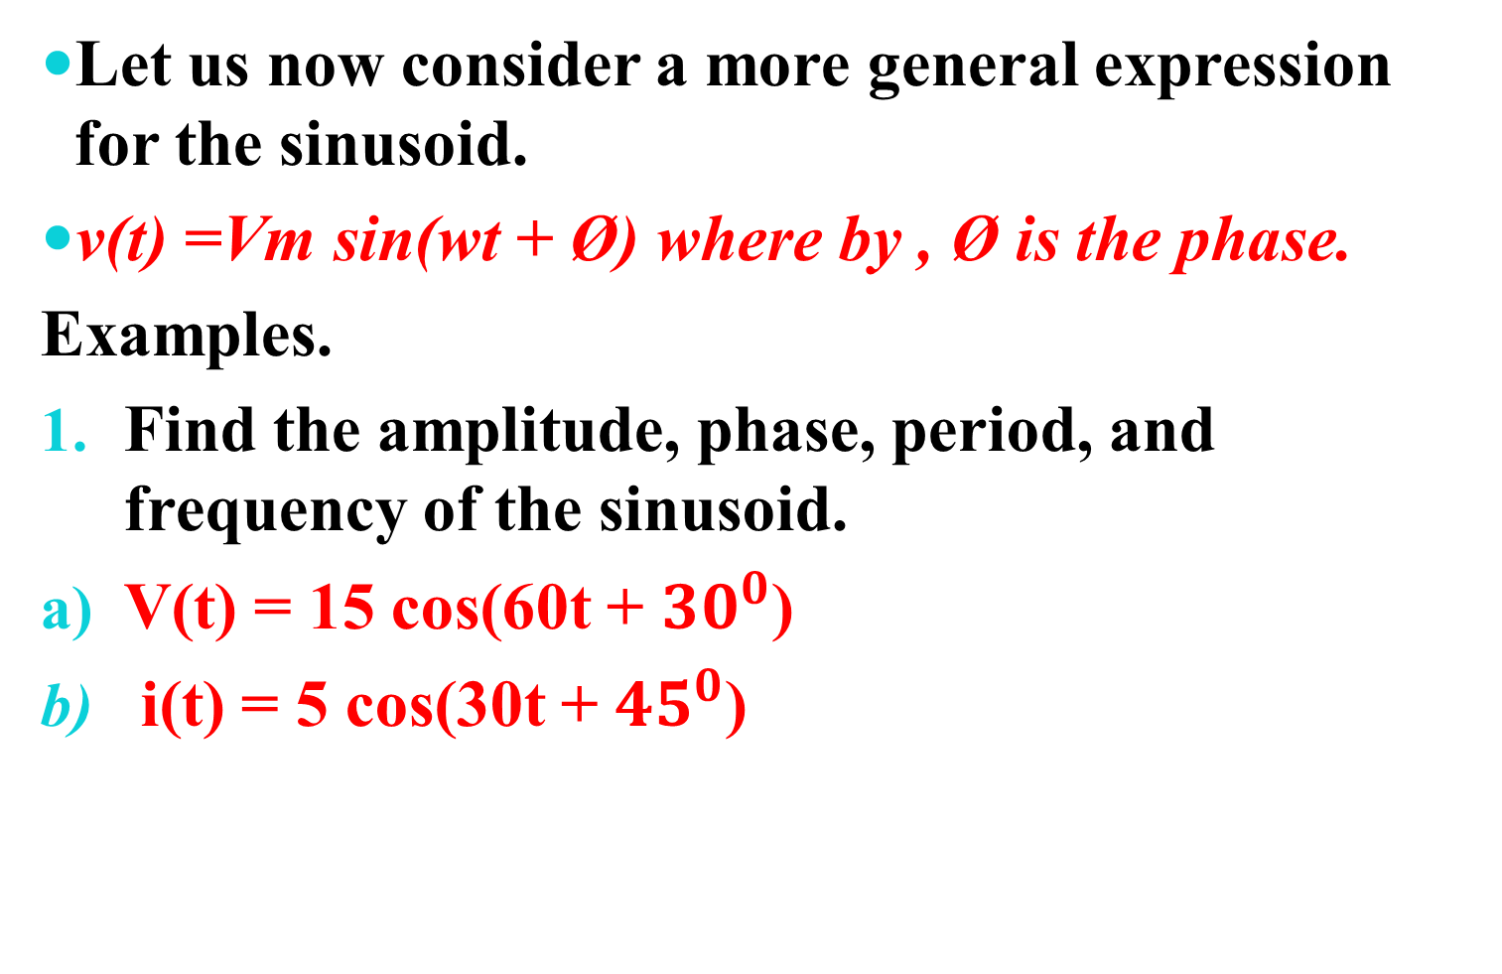
Let us now consider a more general expression for the sinusoid.
v(t) =Vm sin(wt + Ø) where by , Ø is the phase.
Examples.
Find the amplitude, phase, period, and frequency of the sinusoid.
V(t) = 15 cos(60t + ${30}^{0}$)
i(t) = 5 cos(30t + ${45}^{0}$)

Slide 5
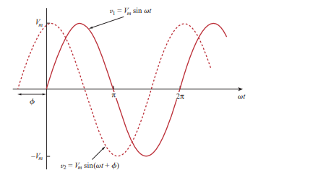

Two sinusoids with different phases.
shown in Fig. below. The starting point${ v}_{2}$ occurs first in time. Therefore, we say that${ v}_{2}$leads${ v}_{1}$by Ø or ${ v}_{1}$lags ${ v}_{2 } by$ Ø

Slide 6
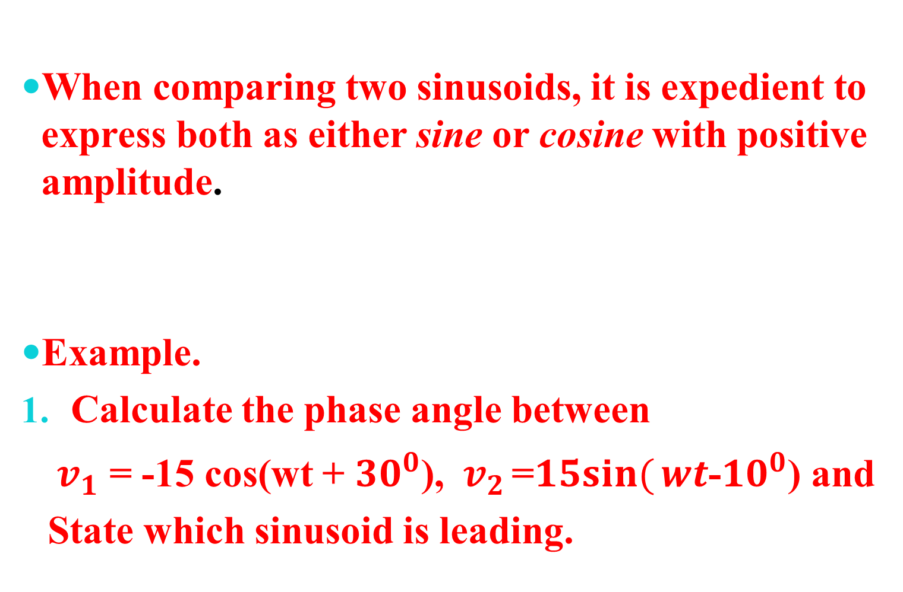
When comparing two sinusoids, it is expedient to express both as either sine or cosine with positive amplitude.
Example.
Calculate the phase angle between
${ v}_{1}$ = -15 cos(wt + ${30}^{0}$), ${ v}_{2 }$=$15sin({wt­}$­-${10}^{0}$) and
State which sinusoid is leading.

Slide 7
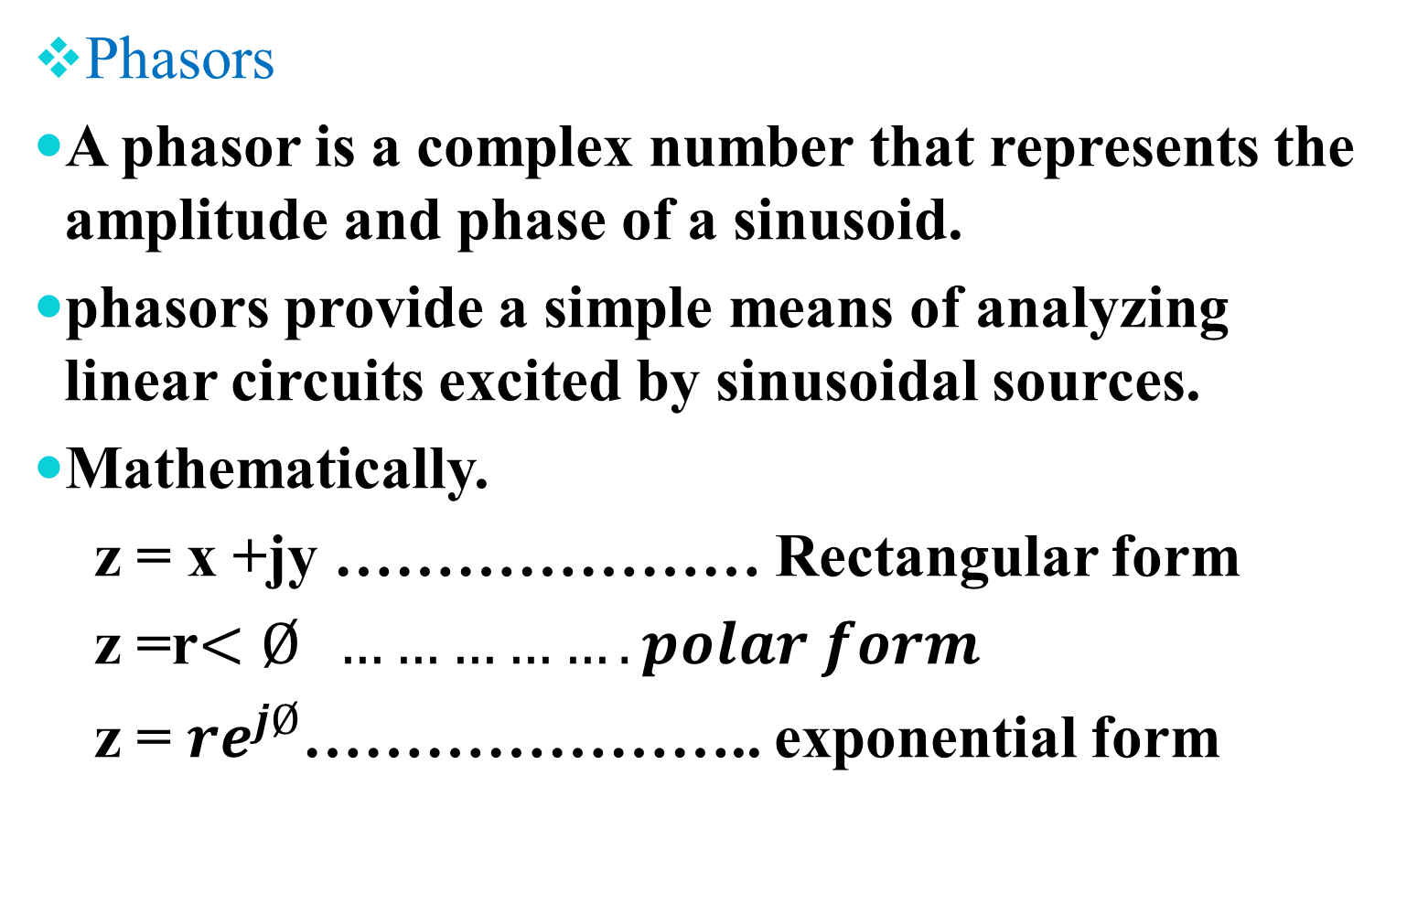
Phasors
A phasor is a complex number that represents the amplitude and phase of a sinusoid.
phasors provide a simple means of analyzing linear circuits excited by sinusoidal sources.
Mathematically.
z = x +jy ………………… Rectangular form
z =r$<Ø …………….polar form$
z = ${re}^{jØ}$………………….. exponential form

Slide 8
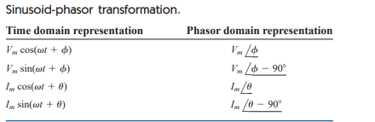

Slide 9

Example.
Transform these sinusoids to phasors:
i= 4 sin(30t - ${60}^{0}$)A , V =6 cos(50t +${30}^{0}$) V

Slide 10
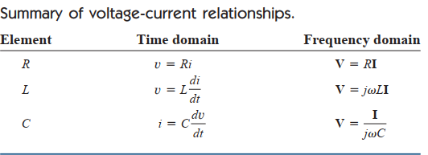
Phasor Relationships for Circuit Elements.

Slide 11
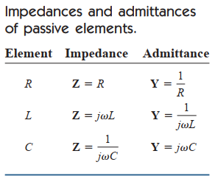

Slide 12
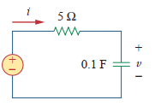
Examples
1.Find V(t) and i(t) in the circuit shown below.where by V(s) ₌10Cos4t.

Slide 13
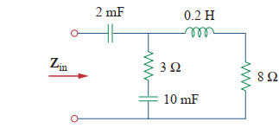
2.(a) Determine The Input Impedance of the circuit below. Assume that the circuit operates at w=60rad/sec.

Slide 14
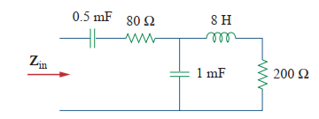
(b) take w=30rad/sec.

Slide 15
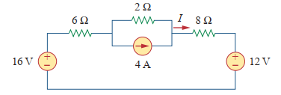
Assignment. (group)
1.State the following theorem ;
Thevenin
Norton
Superposition.
2.Using Superposition theorem to calculate the value of current in the circuit below.

Slide 16
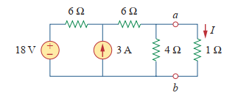
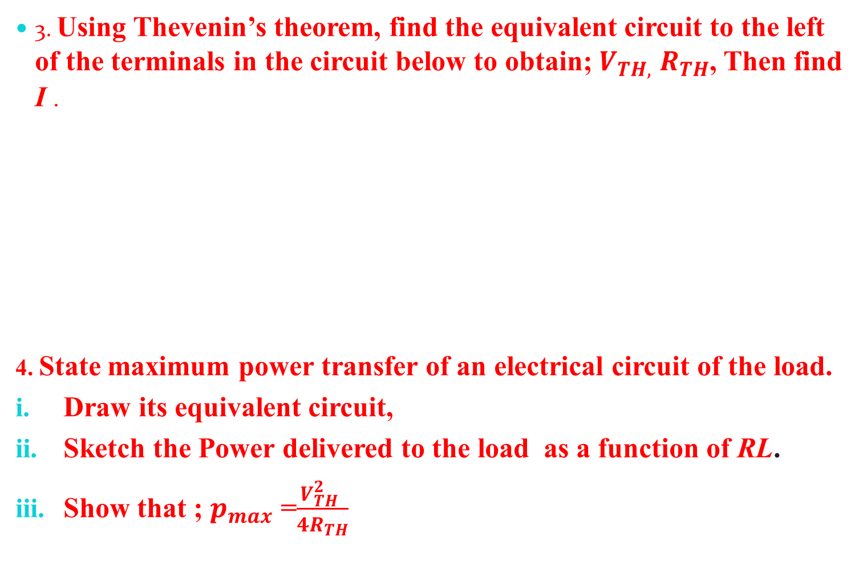
3. Using Thevenin’s theorem, find the equivalent circuit to the left of the terminals in the circuit below to obtain; $V_{TH,}$ $R_{TH}$, Then find I .
4. State maximum power transfer of an electrical circuit of the load.
Draw its equivalent circuit,
Sketch the Power delivered to the load as a function of RL.
Show that ; $p_{max}$ =$\frac{V_{TH}^{2} }{4R_{TH}}$

Slide 17
………..GOOD LUCK………
THE END OF LECTURE TWO.

